Slide 1
Klimatska strategija sa akcionim planom, sa osvrtom na buduća očekivanja vezano za sektor industrije
Matej Gasperic
„Biomasom ka dekarbonizaciji cementne industrije, Paraćin 6.11.2018“

Slide 2
Content of the presentation
Project Structure and components of the project
Modelling suite for Serbia
Macroeconomic Modelling Assumption and Exogenous parameters
Macroeconomic Modelling results
Baseline Results
Mitigation Scenarios set-up – Elements relevant for Cement Industry
Expectations for the Cement Industry

Slide 3
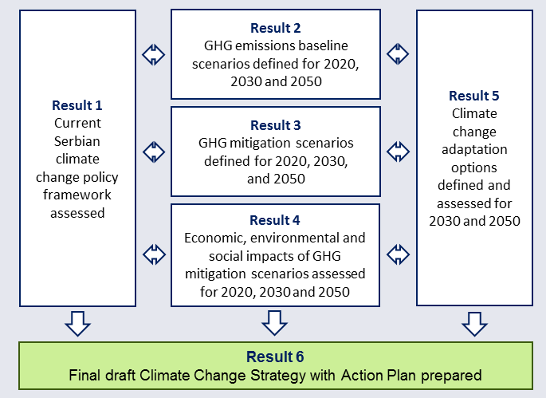
Project structure and components

Slide 4
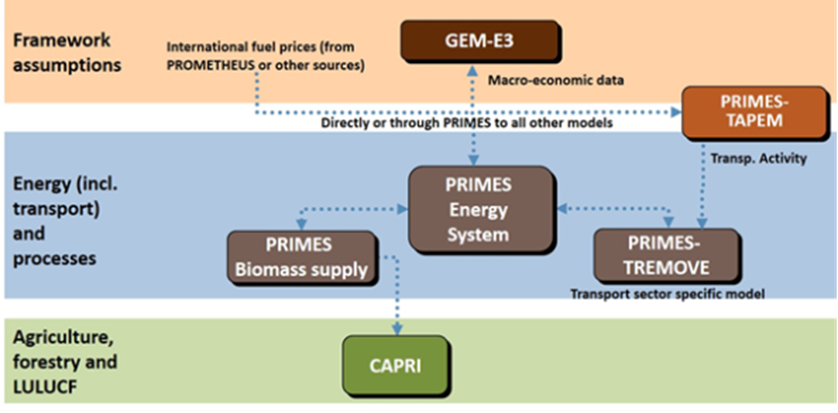
R2/R3-Modelling suite for Serbia‘s GHG projections
FAO-GFA Serbia
Waste
Sector
IPCC 2006 Waste model

Slide 5
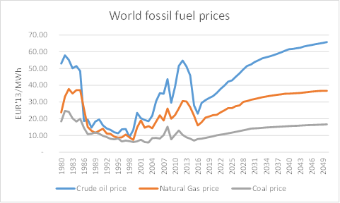
External modeling inputs
Source: Prometheus model and E3M
PROMETHEUS is a world stochastic energy system model developed and maintained by E3-Modelling staff. The model manual is available at http://147.102.23.135/e3mlab/PROMETHEUS%20Manual/The%20PROMETHEUS%20MODEL.pdf

Slide 6
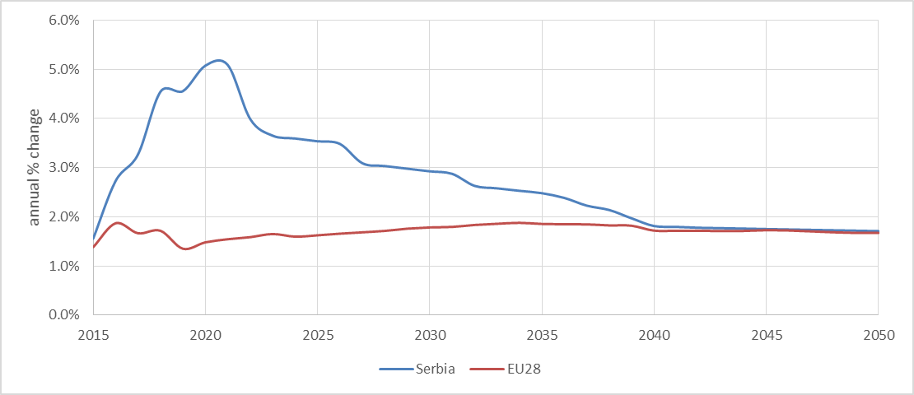
Macroeconomic Modeling assumptions
Labour productivity
The key trend in the growth of labour productivity is that it will surpass the EU average until 2040 and it will converge right afterwards
The labour productivity assumed is consistent with the population projections of the statistical office and the projections of declining unemployment rate until 2050.

Slide 7
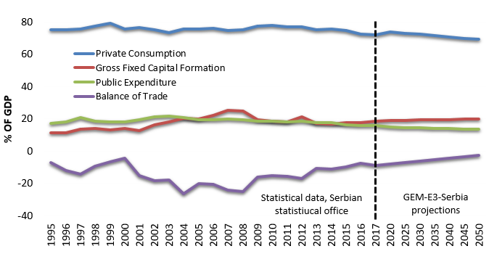
Macroeconomic Modeling assumptions/results

Slide 8
Macroeconomic modeling results

Slide 9
Modeling results – Gross Value Added

Slide 10
Modeling results – Cement industry

Slide 11
Baseline scenarios set-up
Two baseline scenarios have been developed for the energy sector of Serbia using the PRIMES & GEM-E3 modelling suite, namely a
Baseline scenario B1 and
Baseline scenario B2.
The differentiating factor between the two baseline scenarios is the energy-related policies that are taken into consideration.
Both baseline scenarios take into consideration only policies and measures that are in effect in 2015 .
Baseline scenarios and carbon prices [2015-2050] :
CARBON PRICE in ETS = 0€/tCO2
CARBON PRICE in non-ETS =0€/tCO2

Slide 12
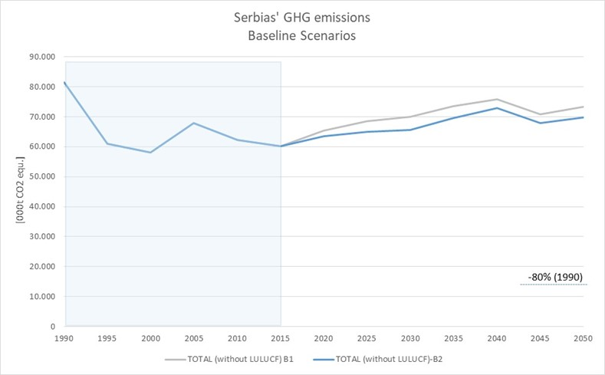
R2-Results overview
-14,2%
-19,5%
+16,1%
+9,0%

Slide 13
Mitigation scenarios set-up
M1 Scenario – Elements relevant for Cement Industry
Full implementation of the EU-ETS ( taking into account current EU level of ambition)
No carbon price for the non-ETS sector

Slide 14
External Modeling inputs for mitigation scenarios

Slide 15
Mitigation scenarios set-up
M3 Scenario - Elements relevant for Cement Industry
Full implementation of the EU acquis (bottom up)
Full implementation of the EU-ETS (taking into account 2030 and 2050 level of ambition e.g. -80% in 2050 compare to 1990 levels)
Full implementation of the Effort Sharing decision (top down)

Slide 16
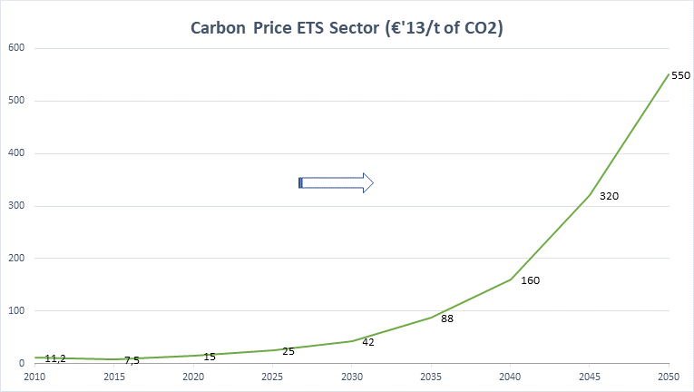
External Modeling inputs for mitigation scenarios
Potential

Slide 17
Expectations for the Cement Industry
Expectations for Cement industry in the Climate strategy and action plan
Cement industry is to prepare for the full implementation of the EU-ETS in Serbia
Draft law on climate change is to introduce MRV in the Serbia‘s ETS Sector
Serbia is a Carbon price taker – no options for affecting the EU CO2 price
Modeling date for full implementation of the EU-ETS is 2025
By then no specific PaMs are considered for the energy intensive industry sector at this stage of preparation of the Strategy and Action plan
EU starting point for determination of annual reduction rate for benchmark value update = 0,766tCO2/tclinker.

Slide 18
Drafting Strategy and Action plan
Hvala na pažnji !
www.klimatskastrategija.eu

